Slide 1

HEART DISEASE DIAGNOSTIC ANALYSIS
-PREET JITENDRA JAIN

Slide 2


PROJECT DETAILS
Project Title | Heart Disease Diagnostic Analysis
Technology | Data Science
Domain | Healthcare
Project Difficulty Level | Intermediate
Programming Language used | Python
Tools Used | Google Colab, Power BI, Excel, Canva

Slide 3


INTRODUCTION
Health is real wealth in the pandemic time we all realized the brute effects of covid-19 on all
irrespective of any status. You are required to analyze this health and medical data for better future preparation.

Slide 4

DATASET INFORMATION
Age: The person's age in years
Sex: The person's sex (1 = male, 0 = female)
Cp: The chest pain experienced (Value 1: typical angina, Value 2: atypical angina, Value 3: non-anginal pain, Value 4: asymptomatic)
Trestbps: The person's resting blood pressure (mm Hg on admission to the hospital)
Exang: Exercise induced angina (1 = yes; 0 = no)
Oldpeak: ST depression induced by exercise relative to rest
ca: The number of major vessels (0-3)

Slide 5
DATASET INFORMATION
slope: the slope of the peak exercise ST segment (Value 1: up sloping, Value 2: flat, Value 3: down sloping)
thal: A blood disorder called thalassemia (3 = normal; 6 = fixed defect; 7 = reversable defect)
num: Heart disease (0 = no, 1 = yes)
fbs: The person's fasting blood sugar (> 120 mg/dl, 1 = true; 0 = false)
restecg: Resting electrocardiograph's measurement (0 = normal, 1 = having ST-T wave
abnormality, 2 = showing probable or definite left ventricular hypertrophy by Estes' criteria)
thalach: The person's maximum heart rate achieved

Slide 6
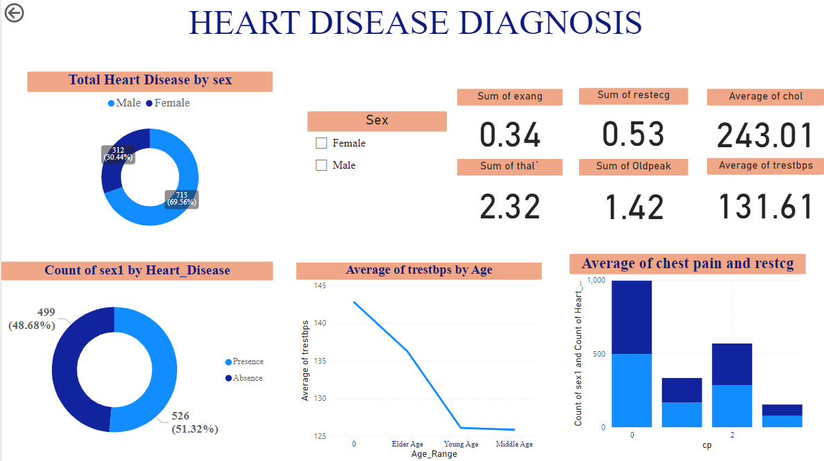

Slide 7


Key Performance Indicator (KPI)
Gender Distribution Based on Heart Disease.
Range of Age Distribution According to their Gender.
Chest Pain Experienced According to Range of Age Based on Heart Disease.
Chest Pain Experienced in Different Age Group Based on their Gender.
Average of Cholesterol Level and The person's maximum heart rate achieved Based on Heart Disease
The Average of person's resting blood pressure.

Slide 8

THANK YOU

